Slide 1
Generalising Finite Difference Methods and Schrodinger equation
PHYS3112 – Tutorial 6

Slide 2
Today we will:
Generalising the 1d Poisson equation to work with 2 different materials
Generalising the 1d Poisson equation to 2D
Implement the tri-diagonal matrix form of an eigenvalue problem.
Solve for the energy states in a 1D potential well using the Schrodinger equation
Basically, a whole lot of matrix manipulation in python

Slide 3
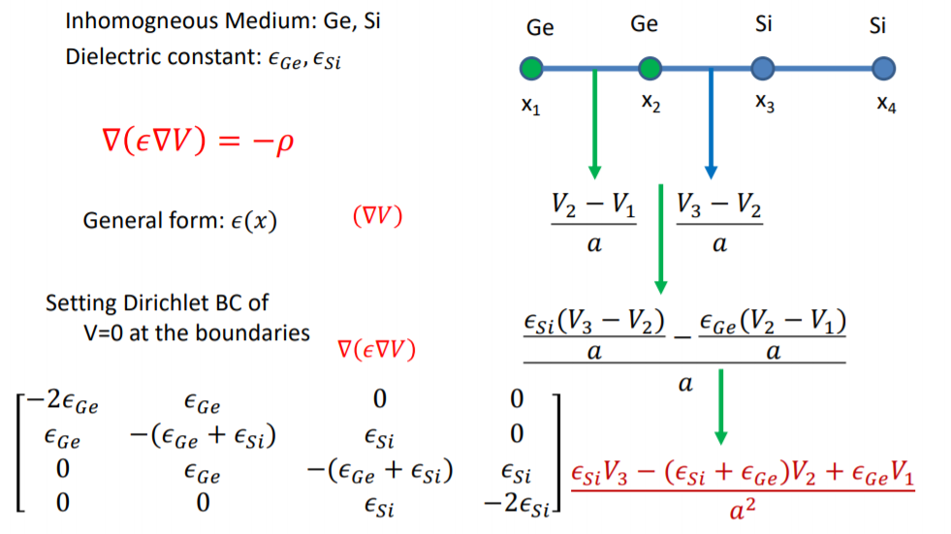
Inhomogeneous Poisson

Slide 4


Inhomogeneous Poisson
ε₀
x₀
ε₀
x₁
ε₀
x₂
ε₁
x₃
ε₁
x₄
$\left[\begin{matrix}−2ε_{0} & ε_{0} & 0 & 0 & 0 \\ ε_{0} & −2ε_{0} & ε_{0} & 0 & 0 \\ 0 & ε_{0} & −(ε_{0}+ε_{1}) & ε_{1} & 0 \\ 0 & 0 & ε_{0} & −(ε_{0}+ε_{1}) & ε_{1} \\ 0 & 0 & 0 & ε_{1} & −2ε_{1}\end{matrix}\right]$ =
$$ε_{0} \left[\begin{matrix}−2 & 1 & 0 & 0 & 0 \\ 1 & −2 & 1 & 0 & 0 \\ 0 & 1 & −1 & 0 & 0 \\ 0 & 0 & 1 & −1 & 0 \\ 0 & 0 & 0 & 0 & 0\end{matrix}\right]+ε_{1}\left[\begin{matrix}0 & 0 & 0 & 0 & 0 \\ 0 & 0 & 0 & 0 & 0 \\ 0 & 0 & −1 & 1 & 0 \\ 0 & 0 & 0 & −1 & 1 \\ 0 & 0 & 0 & 1 & −2\end{matrix}\right]$$

Slide 5
Inhomogeneous Poisson
ε₀
x₀
ε₀
x₁
ε₀
x₂
ε₁
x₃
ε₁
x₄
$\left[\begin{matrix}−2ε_{0} & ε_{0} & 0 & 0 & 0 \\ ε_{0} & −2ε_{0} & ε_{0} & 0 & 0 \\ 0 & ε_{0} & −(ε_{0}+ε_{1}) & ε_{1} & 0 \\ 0 & 0 & ε_{0} & −(ε_{0}+ε_{1}) & ε_{1} \\ 0 & 0 & 0 & ε_{1} & −2ε_{1}\end{matrix}\right]$ =
$$ε_{0} \left[\begin{matrix}−2 & 1 & 0 & 0 & 0 \\ 1 & −2 & 1 & 0 & 0 \\ 0 & 1 & −1 & 0 & 0 \\ 0 & 0 & 1 & −1 & 0 \\ 0 & 0 & 0 & 0 & 0\end{matrix}\right]+ε_{1}\left[\begin{matrix}0 & 0 & 0 & 0 & 0 \\ 0 & 0 & 0 & 0 & 0 \\ 0 & 0 & −1 & 1 & 0 \\ 0 & 0 & 0 & −1 & 1 \\ 0 & 0 & 0 & 1 & −2\end{matrix}\right]$$

Slide 6


Inhomogeneous Poisson
ε₀
x₀
ε₀
x₁
ε₀
x₂
ε₁
x₃
ε₁
x₄
$$\left[\begin{matrix}−2 & 1 & 0 & 0 \\ 1 & −2 & 1 & 0 \\ 0 & 1 & −1 & 0 \\ 0 & 0 & 1 & −1\end{matrix}\right]=TriDiag_{4x4}+\left[\begin{matrix}0 & 0 & 0 & 0 \\ 0 & 0 & 0 & 0 \\ 0 & 0 & 1 & −1 \\ 0 & 0 & 0 & 1\end{matrix}\right]$$
$$\left[\begin{matrix}−1 & 1 & 0 \\ 0 & −1 & 1 \\ 0 & 1 & −2\end{matrix}\right]=TriDiag_{3x3}+\left[\begin{matrix}1 & 0 & 0 \\ −1 & 1 & 0 \\ 0 & 0 & 0\end{matrix}\right]$$

Slide 7
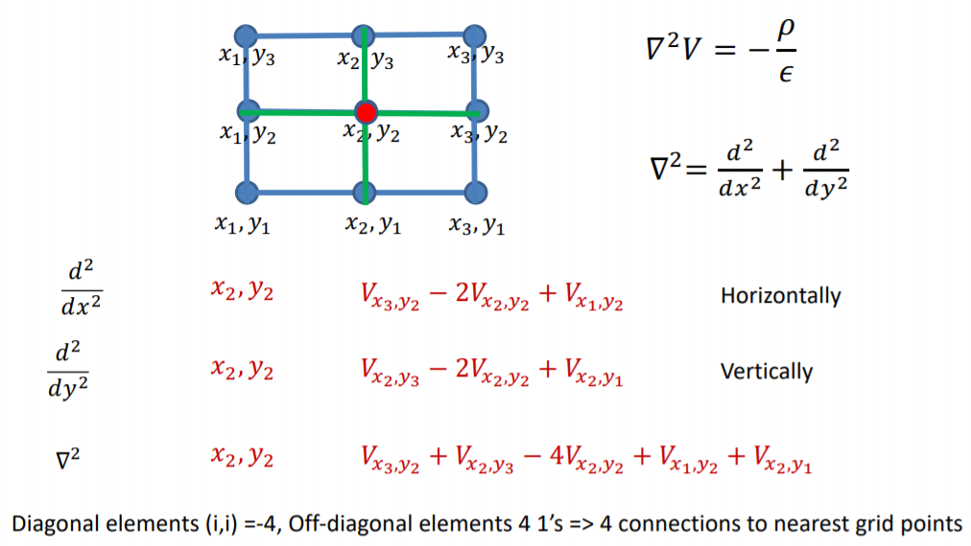
2D Poisson

Slide 8
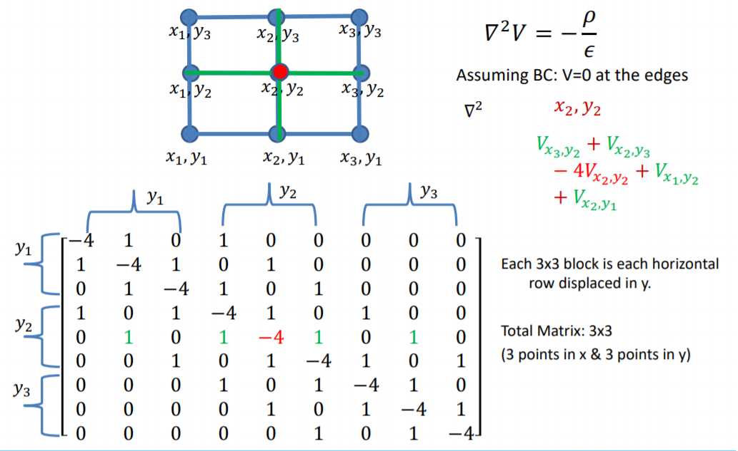
2D Poisson
x₁
x₂
x₃
x₁
x₂
x₃
x₁
x₂
x₃

Slide 9

2D Poisson – mesh grids
$$x_{mesh}=\left[\begin{matrix}0 & 1 & 2 & 3 & 4 \\ 0 & 1 & 2 & 3 & 4 \\ 0 & 1 & 2 & 3 & 4 \\ 0 & 1 & 2 & 3 & 4 \\ 0 & 1 & 2 & 3 & 4\end{matrix}\right]$$
$$y_{mesh}=\left[\begin{matrix}0 & 0 & 0 & 0 & 0 \\ 1 & 1 & 1 & 1 & 1 \\ 2 & 2 & 2 & 2 & 2 \\ 3 & 3 & 3 & 3 & 3 \\ 4 & 4 & 4 & 4 & 4\end{matrix}\right]$$
$$ρ=\left[\begin{matrix}0 & 1 & 2 & 3 & 4 \\ 0 & 1 & 2 & 3 & 4 \\ 0 & 1 & 2 & 3 & 4 \\ 0 & 1 & 2 & 3 & 4 \\ 0 & 1 & 2 & 3 & 4\end{matrix}\right]+\left[\begin{matrix}0 & 0 & 0 & 0 & 0 \\ 1 & 1 & 1 & 1 & 1 \\ 2 & 2 & 2 & 2 & 2 \\ 3 & 3 & 3 & 3 & 3 \\ 4 & 4 & 4 & 4 & 4\end{matrix}\right]$$

Slide 10

What’s an Eigenvalue Problem?
A simulation setup where instead of finding the state of the system (and progressing through time), we want to determine what states possibly fit the conditions).
Our goal: Given H, find all the E and phi that fit.
Fortunately, these are easy to solve computationally (because someone has already made a function for us!)

Slide 11
Numpy.linalg.eigh
Put the Hamiltonian matrix H in, and you get Eigenvalues (W) and corresponding eigenvectors (V)
W, V = numpy.linalg.eigh(H)
(This is like linalg.eig, but it’s specifically for hamiltonians (i.e. tri-diagonal matrices). The eigenvalues also come out in order which is very helpful.)
W is a vector with all the eigenvalues
V is a matrix, where each column is an eigenvector
So the 1st eigenvector will be V[:,0] (remember python starts counting at 0)

Slide 12



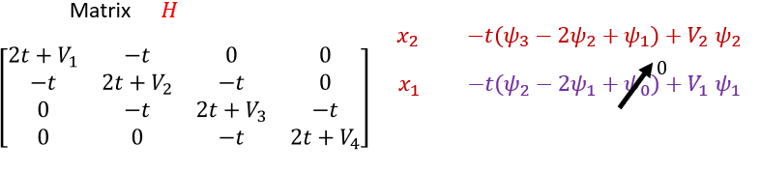
The Time-Independent SE
We generalise it to 1D:
We then need to make it into a Hamiltonian matrix (see lectures!)
(This is assuming that the wavefunction is zero at the ends; our usual boundary condition)

Slide 13
Method of solution
Determine your discretisation regime (number of steps, step size)
Create a V vector defined at each of these steps (i.e. our potential well)
Construct a Hamiltonian matrix
Solve for the eigenvectors using numpy.linalg.eigh
Extract any relevant eigenvalues / vectors and plot them

